Slide 1
Web Services at IRIS Implementations, Directions, and International Coordination
Tim Ahern, Director of Data Services, IRIS
Web Services Team: Bruce Weertman, Yazan Suleiman, Rich Karstens, Rob Casey

Slide 2
What is a web service?
W3C defines a web service as
A software system designed to support interoperable machine to machine interactions over a network
Communication via HTTP protocol
Generally solves the “firewall” problem as services run over port 80
So what does this look like in practice
http://www.iris.edu/ws/timeseries/
query?net=IU&sta=ANMO&loc=00&cha=BHZ
&start=2011-03-11T05.56.00&end=2011-03-11T06.56.00
&scale=AUTO&antialiasplot=true&output=plot&ref=direct

Slide 3
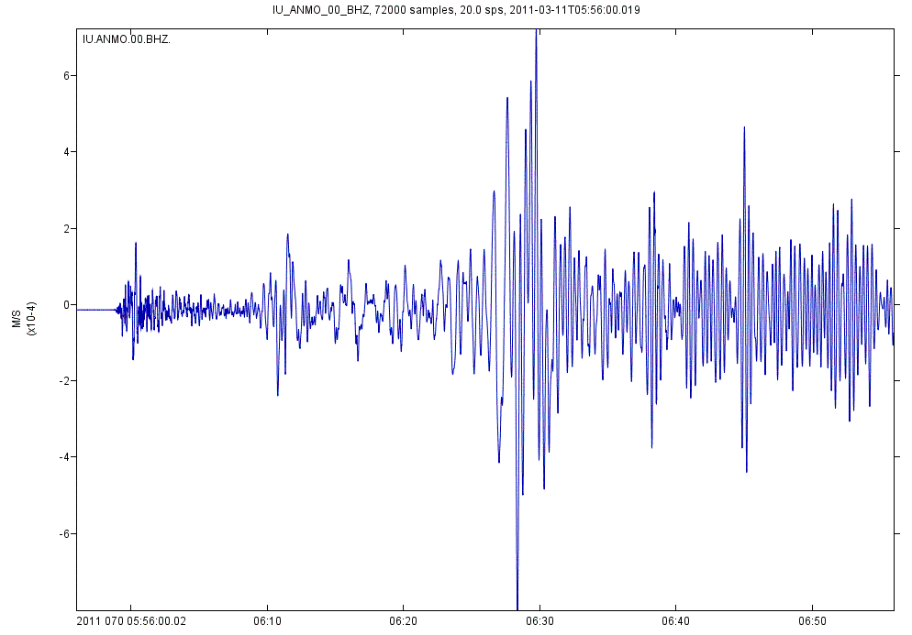
Tohoku Earthquake recorded at Albuquerque gain corrected, anti-aliased plot

Slide 4
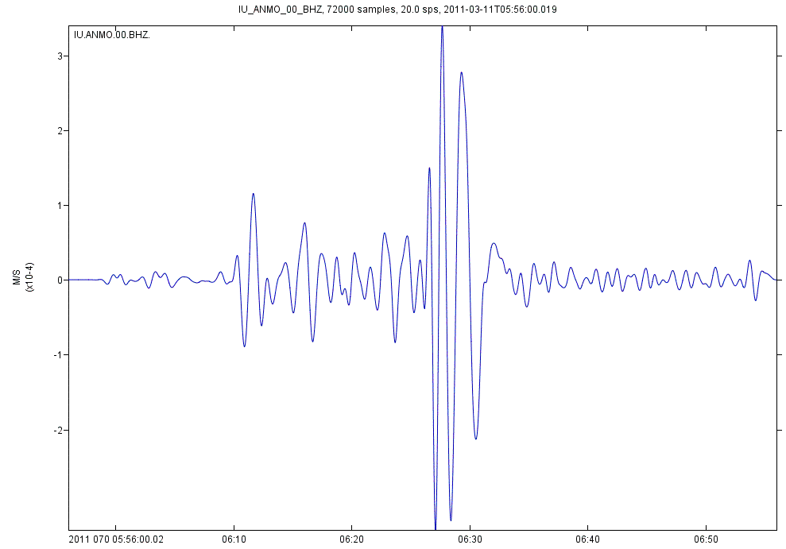
Tohoku Earthquake Low Pass Filtered at 0.02 hertz (50 seconds)
&lpfilter=0.02

Slide 5
IRIS Services
Data Access Services
Waveforms
Metadata
Events
Products
Data Processing Services
Digital Signal Processing
Filtering
Instrument Correction
Rotation

Slide 6
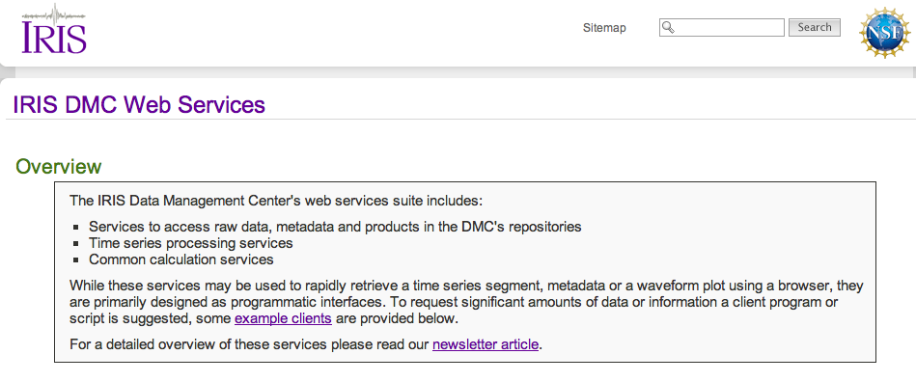
http://www.iris.edu/ws

Slide 7
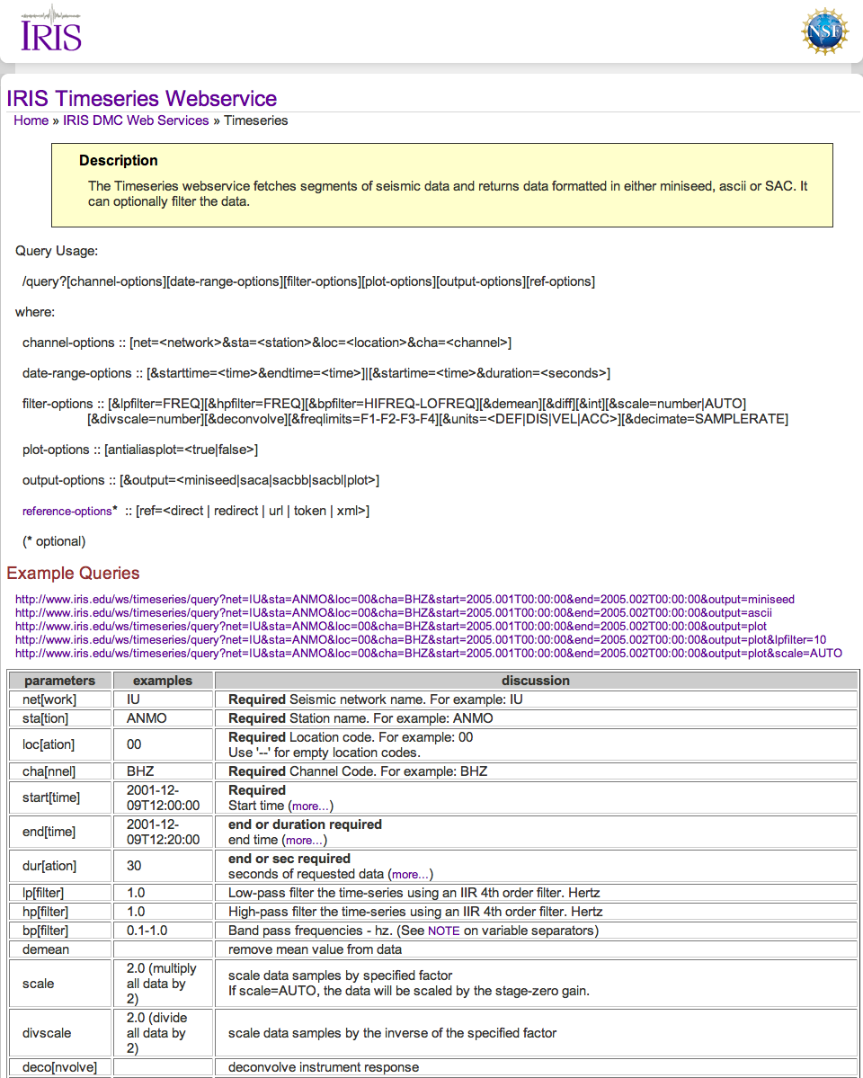
Web service usage
Each service is fully documented
Query usage
Examples
Parameter specification
Usage Notes
URL Builder

Slide 8
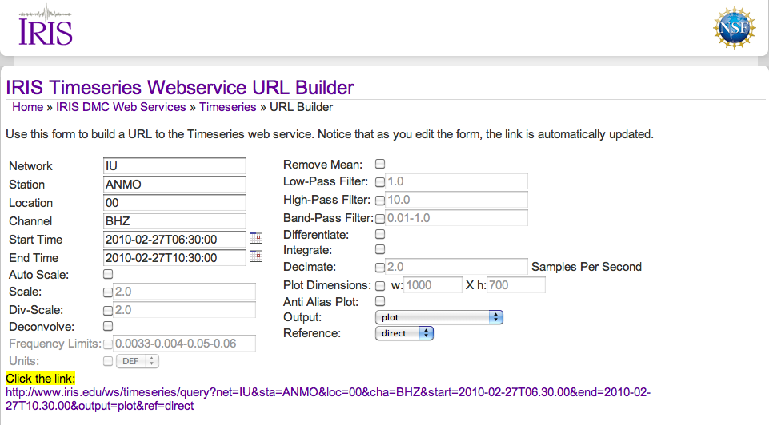
URL Builder

Slide 9
IRIS Services
Raw Waveforms
ws-dataselect
ws-bulkdataselect
Metadata
ws-station
stationXML
Dataless SEED information
ws-resp
ws-sacpz
ws-availability
Events
ws-event
QuakeML

Slide 10
Additional Web Services
Events
ws-event
QuakeML
Products
SPUD
http://www.iris.edu/spud/eventplot/35836
http://www.iris.edu/spud/gmv/35835
Processing
ws-timeseries
Dataselect
Tracedsp
Output options
plotter
mseed2ascii
SAC
ws-distaz
ws-ms2ascii
ws-plotter
ws-tracedsp
Gain correction
Filtering
Instrument deconvolution

Slide 11
Extending IRIS Data to non-seismologists
Traditional Workflow
Generate request for data
Email-based, web-based, CORBA based
Receive Data back in SEED format
Run rdseed to convert into a standard seismological analysis format
Run analysis package
Manipulate Data
Output results
Not a useful workflow for non-seismologists

Slide 12
Web Services for non-seismologists
Familiar URL with query parameter request mechanism
Does not expose native data format
Server side processes
Instrument/gain correction
Units conversion
Digital signal processing
filtering
Conversion to usable format
ASCII 1 column
ASCII 2 column
Graphical display

Slide 13
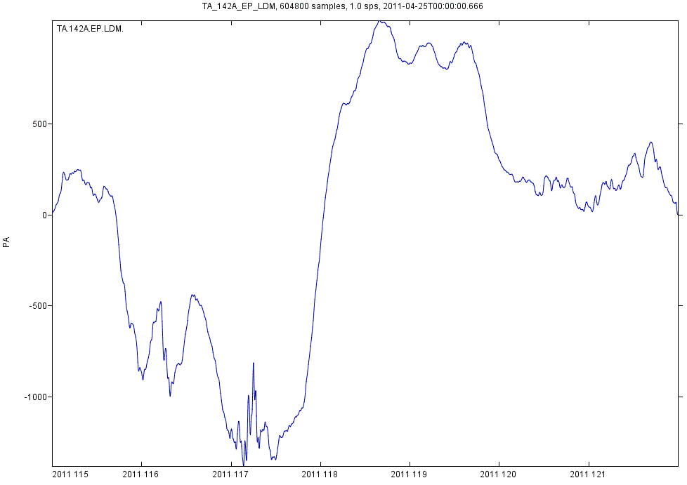
Barometric Pressure Data

Slide 14
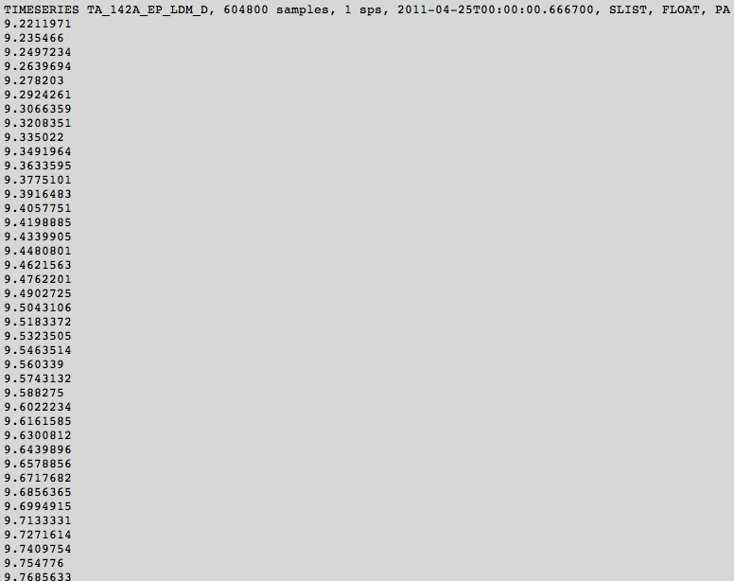
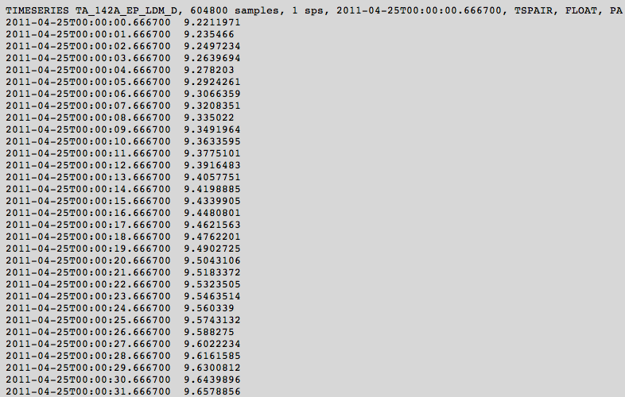
Simple ASCII output

Slide 15
Clients How does one use these services?
Browser
Point your browser to a URI
Good for requests for a few time series
Java clients
Scripts
wget from GNU
curl
Perl
FetchBulkData
FetchMetadata
FetchRESP
FetchSACPZ

Slide 16
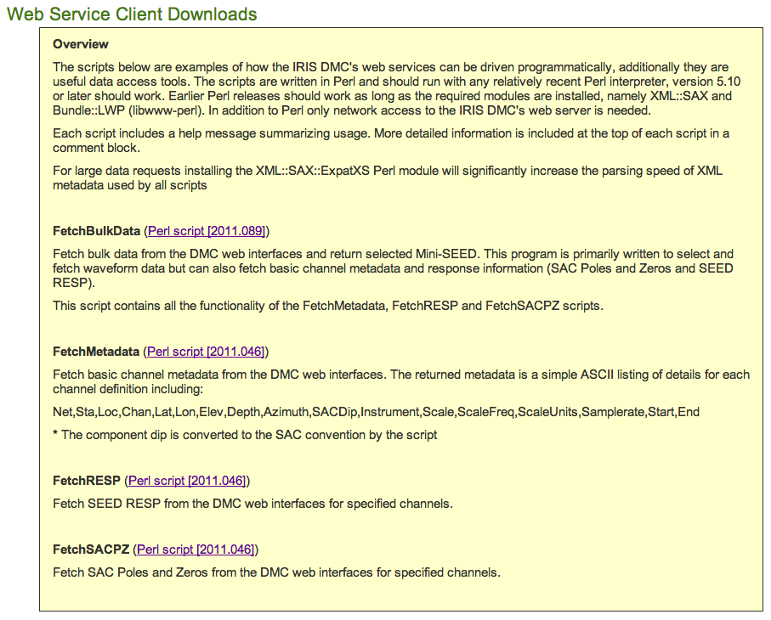
IRIS Sample (and Functional) Clients

Slide 17
FetchBulkData Example
FetchBulkData
-N _GSN -L 00 -C 'BH*'
-s 2011-01-01,00:00:00 -e 2011-01-09,23:59:59
-o /Users/timahern/ws-clients/my.mseed
-m /Users/timahern/ws-clients/my.metadata
mseed2sac my.mseed –m my.metadata
Metadata inserted but not poles & zeroes
Supports
Virtual Networks
* wildcarding

Slide 18
FetchRESP and FetchSACPZ
FetchRESP
-N II –S MSVF -C BHZ -L 00
-s 2011-05-11,00:00:00 -e 2011-05-11,23:59:59
Output is a series of RESP files
FetchSACPZ
-N II –S MSVF -C BHZ -L 00
-s 2011-05-11,00:00:00 -e 2011-05-11,23:59:59
Output is a series of SAC Pole/Zero Files
Supports
Virtual Networks
* wildcarding

Slide 19
FetchMetadata
FetchMetadata
-N II -S MSVF -C 'BH*' -L 00
-s 2011-05-11,00:00:00 -e 2011-05-11,23:59:59
Returns a list of summary lines
II,MSVF,00,BH1,-17.7448,178.0528,801.1,100.0,180.0,90,Geotech KS-54000 Borehole Seismometer,2.5092E9,0.05,M/S,20,2010-07-22T00:00:00,2599-12-31T23:59:59
II,MSVF,00,BH2,-17.7448,178.0528,801.1,100.0,270.0,90,Geotech KS-54000 Borehole Seismometer,2.50656E9,0.05,M/S,20,2010-07-22T00:00:00,2599-12-31T23:59:59
II,MSVF,00,BHE,-17.7448,178.0528,801.1,100.0,270.0,90,Geotech KS-54000 Borehole Seismometer,1.67814E9,0.05,M/S,20,2002-06-06T00:00:00,2007-06-15T23:59:59
II,MSVF,00,BHN,-17.7448,178.0528,801.1,100.0,180.0,90,Geotech KS-54000 Borehole Seismometer,1.67637E9,0.05,M/S,20,2002-06-06T00:00:00,2007-06-15T23:59:59
II,MSVF,00,BHZ,-17.7448,178.0528,801.1,100.0,0.0,0,Geotech KS-54000 Borehole Seismometer,2.30041E9,0.05,M/S,20,2010-07-22T00:00:00,2599-12-31T23:59:59
Same information as FetchBulkData –m option

Slide 20
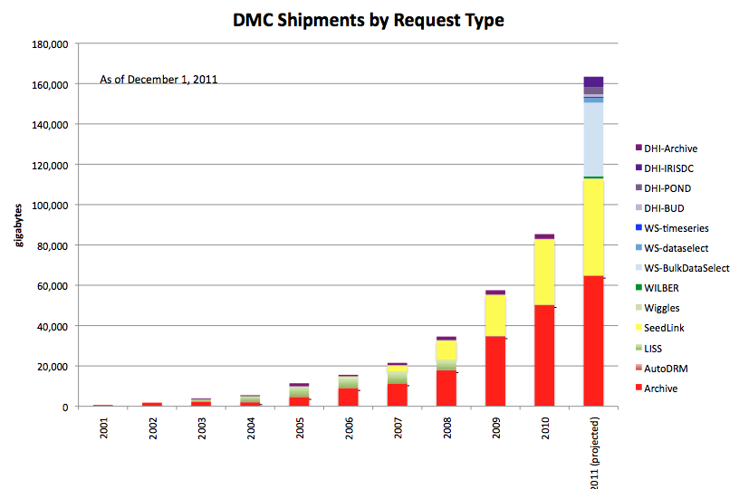
Web Services are already heavily used

Slide 21
Service Oriented Architecture
Metadata
Station
Availability
SACpz
Resp
Client Applications
WILBER III
MUSTANG/QUACK
IRIS Earthquake Browser
jWEED/VASE
Waveforms
Dataselect
Bulkdataselect
Timeseries
Tracedsp
Event
Utilities
distaz
plotter
ms2ascii

Slide 22
Federated Data Centers
WS Data Center
WS Data Center
Metadata
Metadata
Waveform
Waveform
Event
Event
WSClients
FetchBulkData
FetchMetadata
FetchResp
jWeed
WS Data Center
WS Data Center
Metadata
Metadata
Waveform
Waveform
Event
Event

Slide 23
Products
Products are also being developed
Leverage web services
Available via web services

Slide 24
FDSN and Web Services
Coordination taking place between data centers
Europe – ORFEUS – Italy – France – Germany – Switzerland
N. America – IRIS
Others are welcome
FDSN WG II (Data Centers and Data Formats)
Definition of the XML schemas (the payload)
FDSN-StationXML
FDSN-QuakeML
FDSN WG III (Products, Tools, and Services)
Definition of query parameters and usage

